Slide 1

SmileAI
Team members:
Omran Janadi
Osama Abdulhalim
Mahmud Omar

Slide 2
SmileAI is a comprehensive gingival disease support platform that connects:
Mentees - Users with gingival disease seeking guidance and support.
Mentors - Experienced individuals providing peer support and advice.
Doctors - Medical professionals offering expert consultation.
Admins - Platform administrators managing content and user interactions.
Chatbot: an AI agent that answers the questions.
Goal: Create a supportive ecosystem for gingival disease management, treatment adherence, and professional guidance.

Slide 3
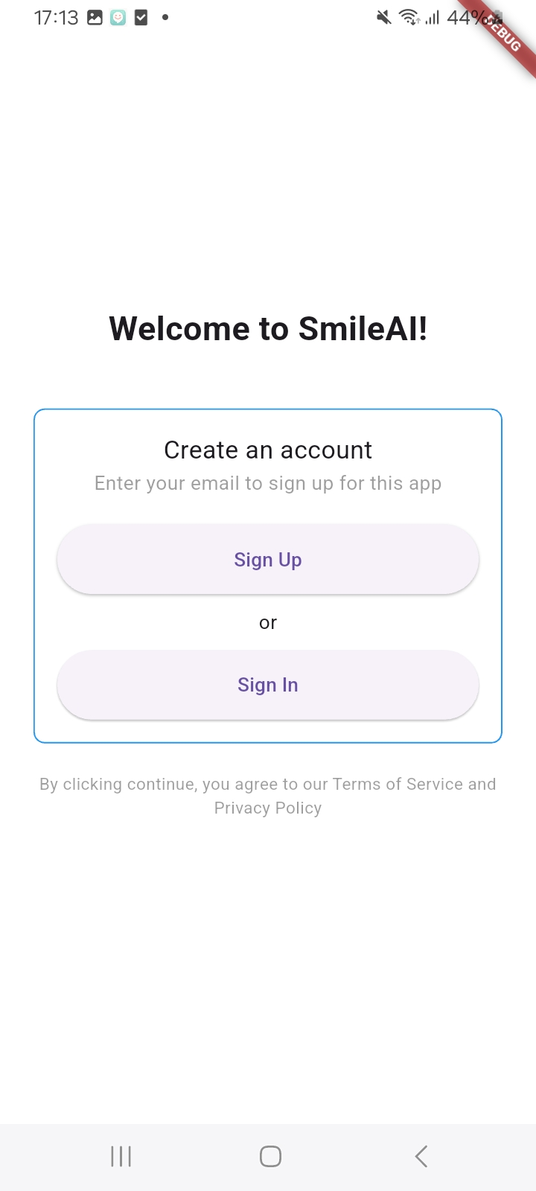
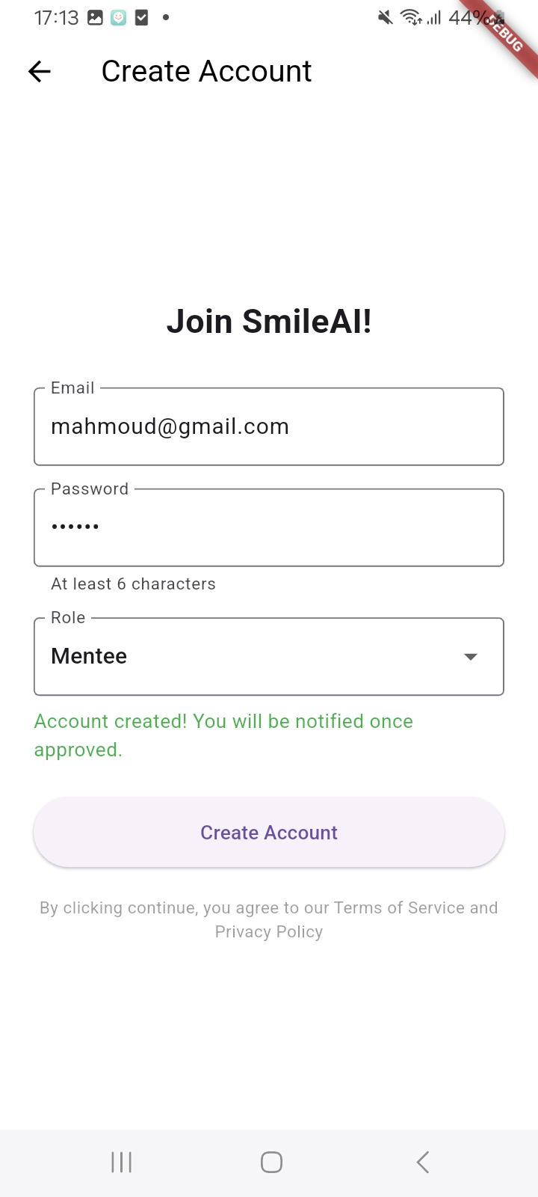
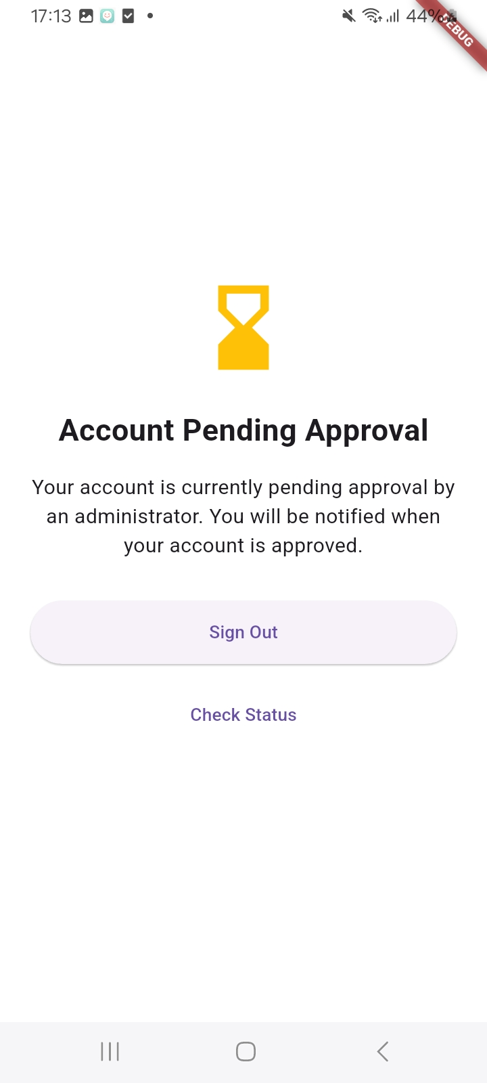
Sign in\ Sign up

Slide 4
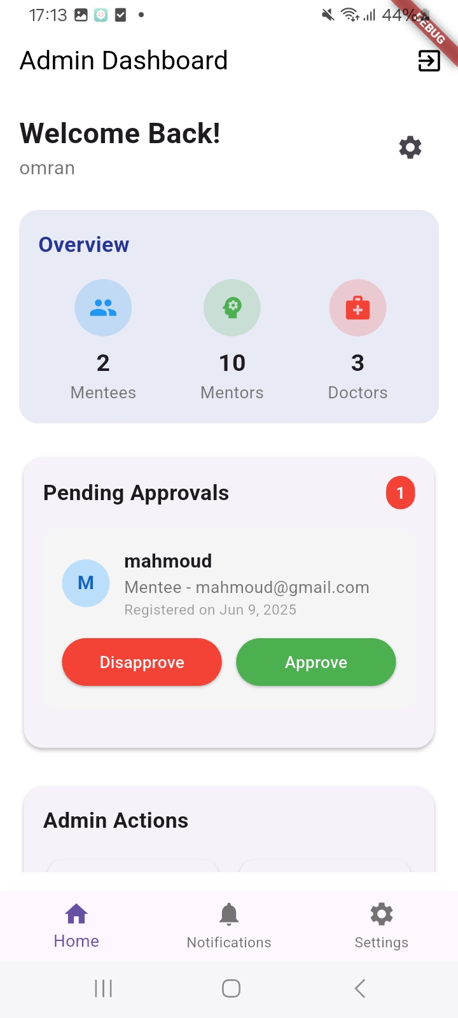
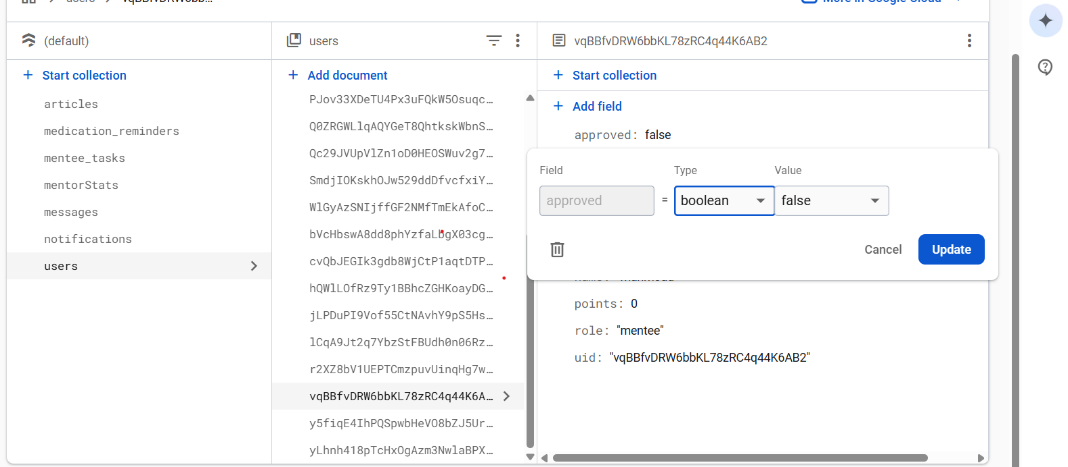
Explanation: Users can choose to sign in or sign up, then wait for admin approval. There are two ways to approve users: within the app (and admin account) or through Firebase.

Slide 5
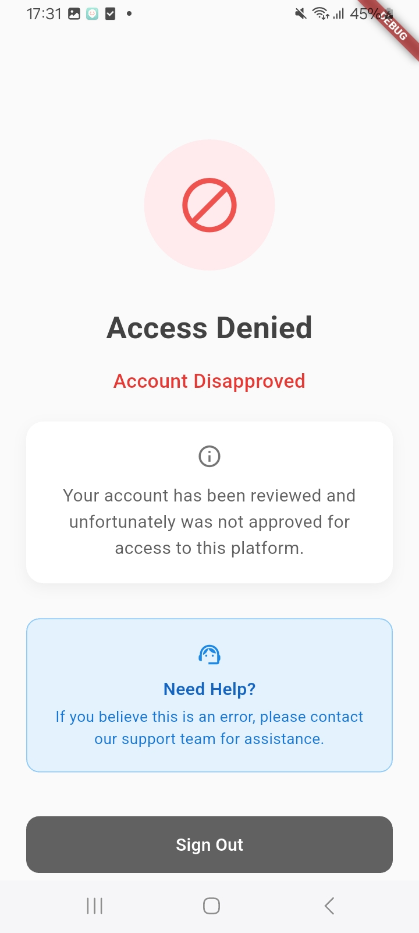
If the admin approve, then the user can sign in normally, otherwise it appears to him the following screen:

Slide 6
Mentee Features
Chat with doctors and mentors, and receive notifications about these messages.
Track tasks that his doctor has assigned to him.
Set up reminders for his medications.
Manage his profile settings - he can change his password, profile picture,
and name.
Read the articles that the admin has added to the app.

Slide 7
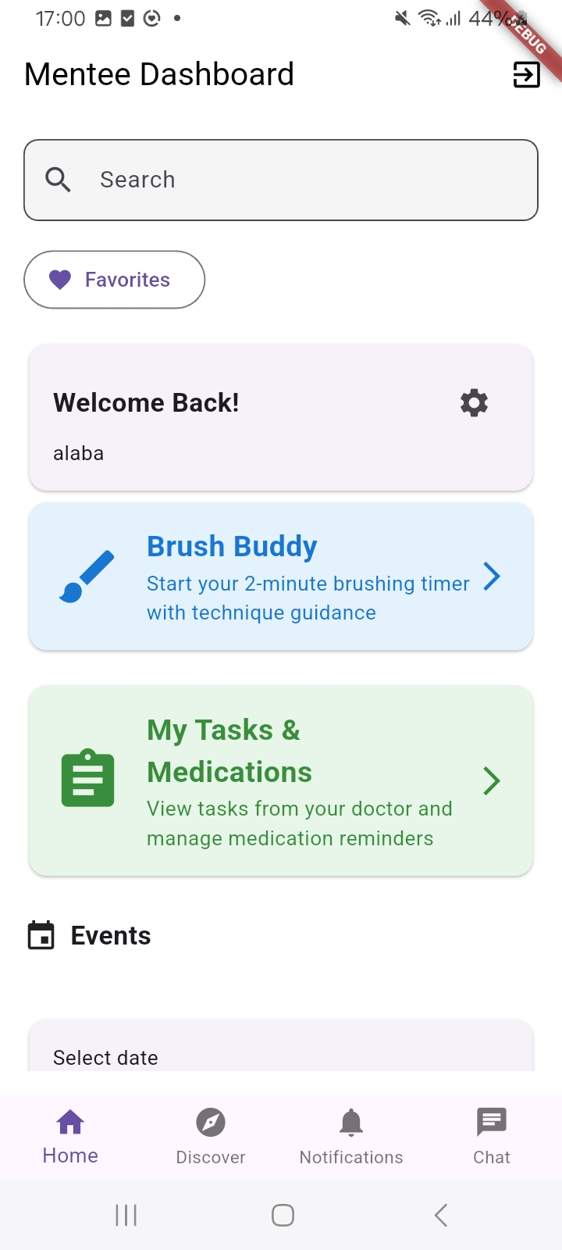
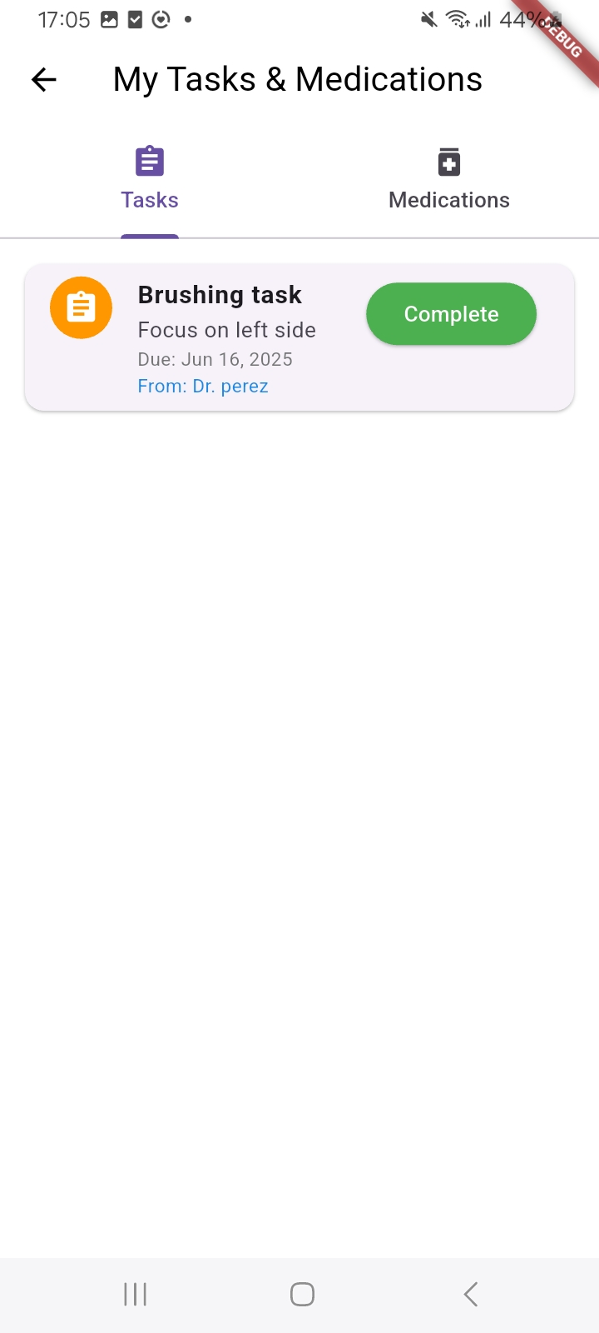
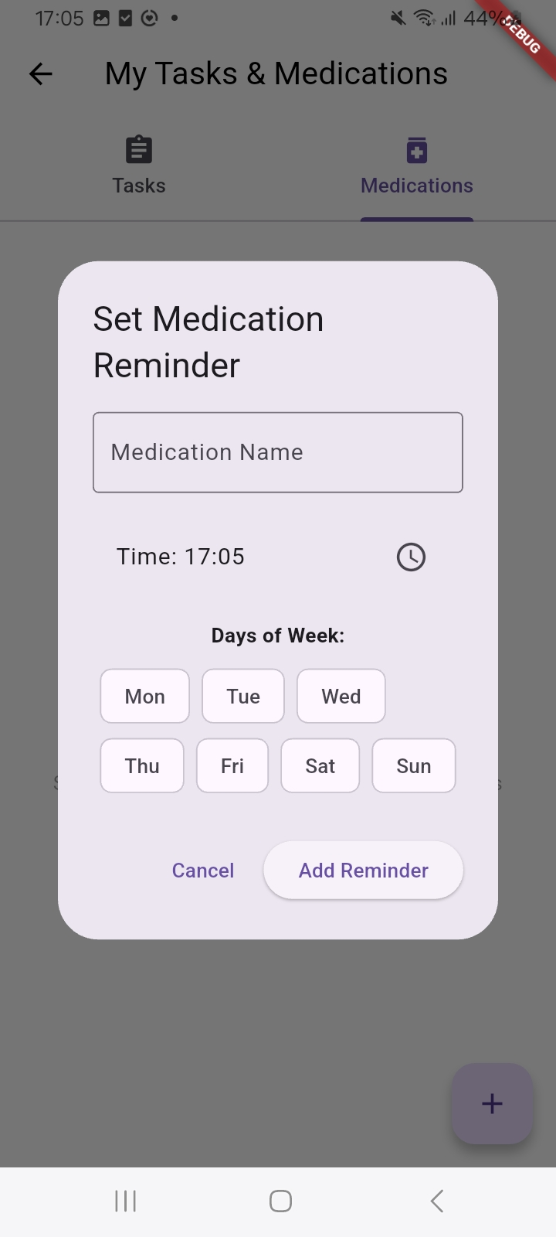
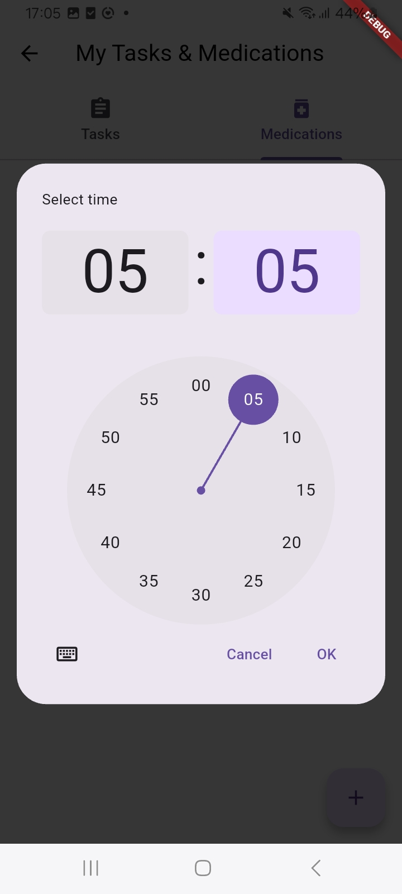
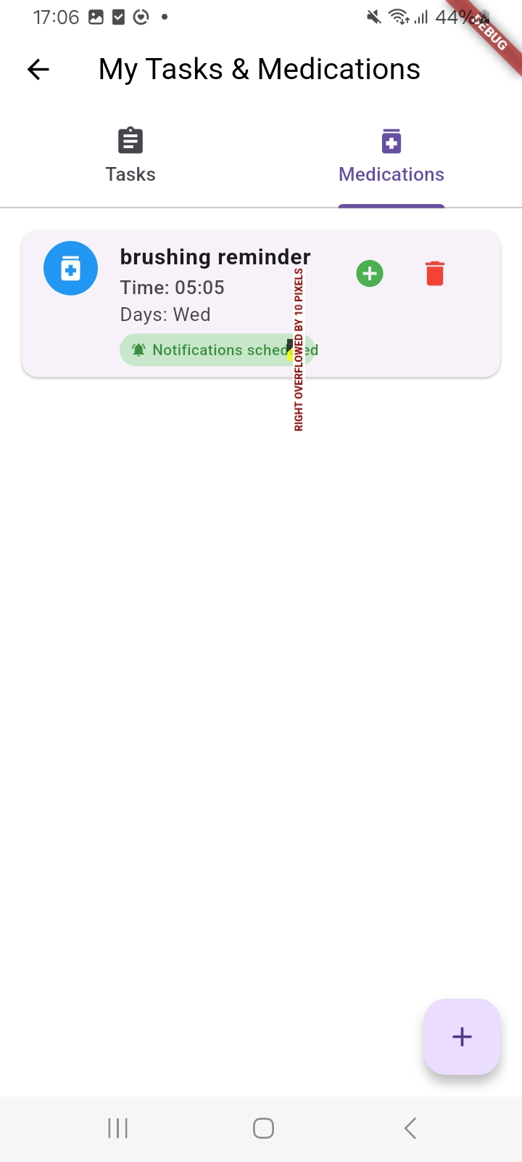
Mentee screens – My tasks&medications

Slide 8
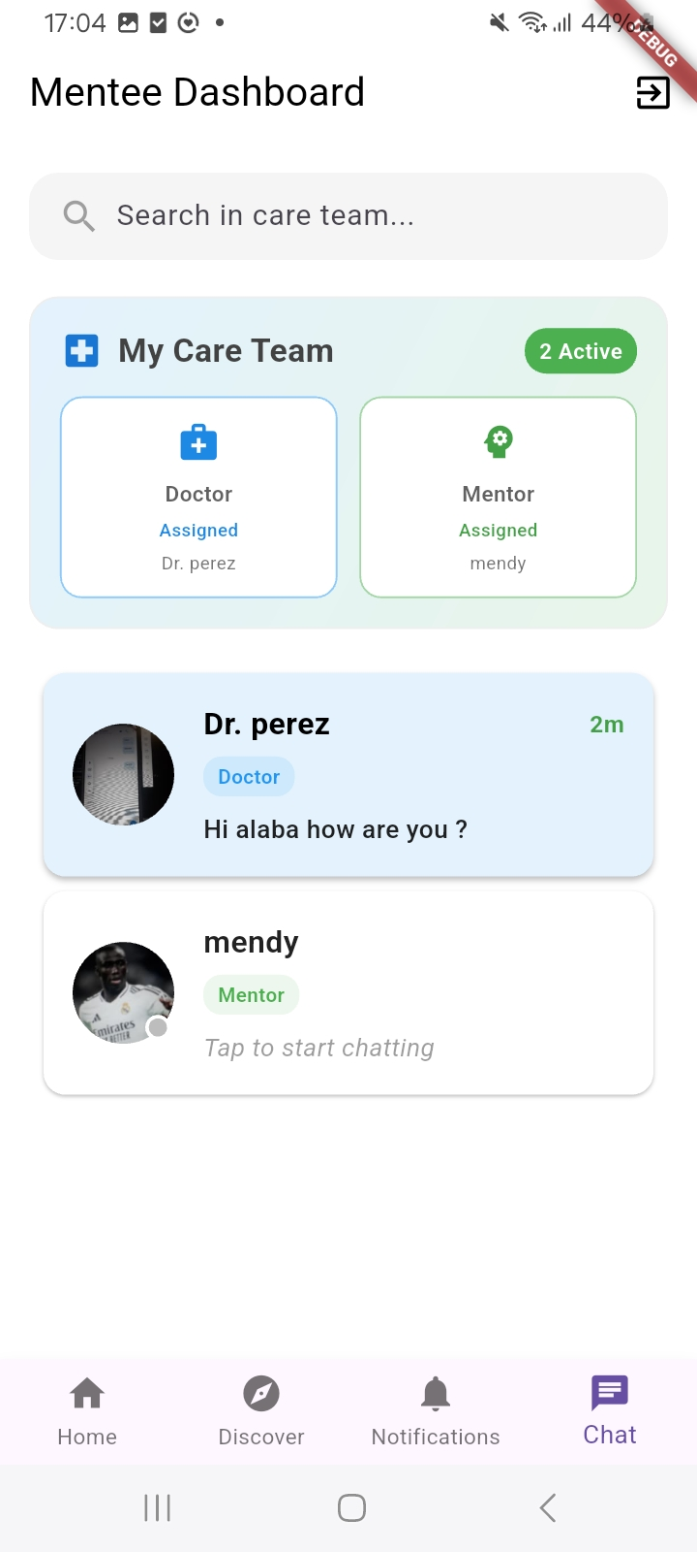
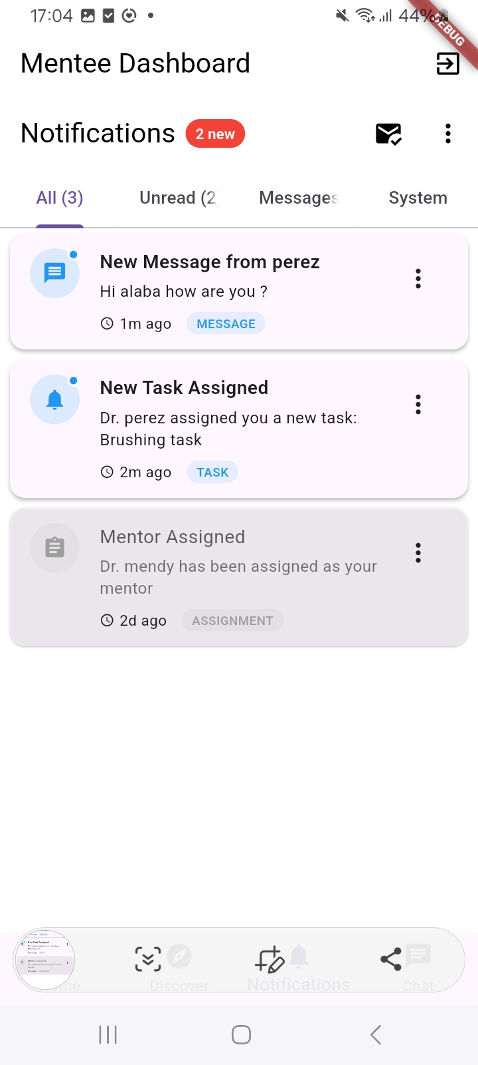
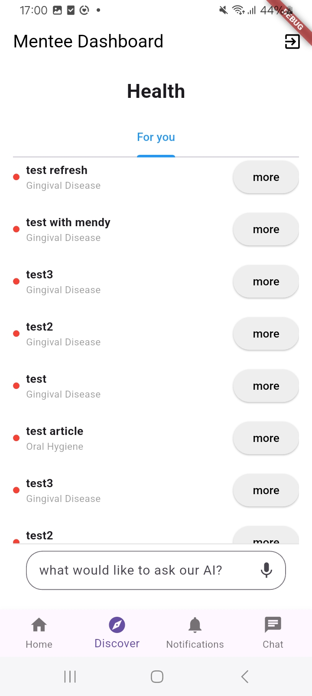
Mentee – Chats and Discover page

Slide 9
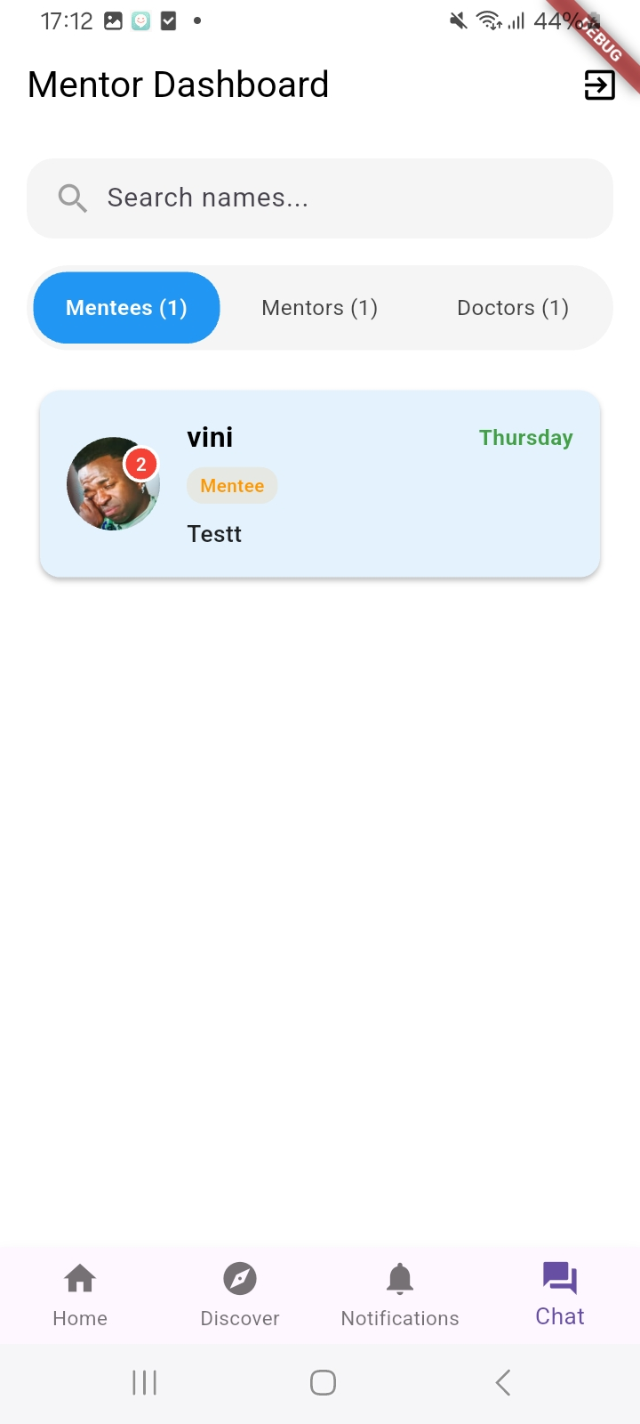
Mentor Features
Same as mentee, apart from having mentees to guide.
Screens:

Slide 10
Doctor features
Chat and interact with his mentees in addition to getting notified about new messages.
Adding tasks for his mentees.
Assign a mentor to one of his mentees.
Reading the admin’s new articles.
Manage his profile settings - he can change his password, profile picture and name, role description.

Slide 11
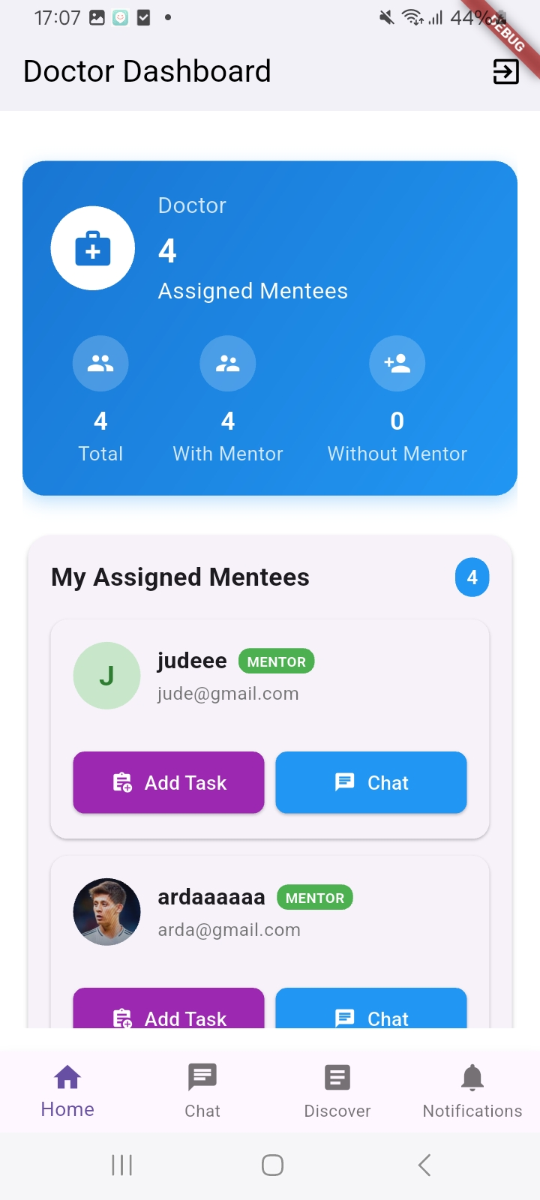
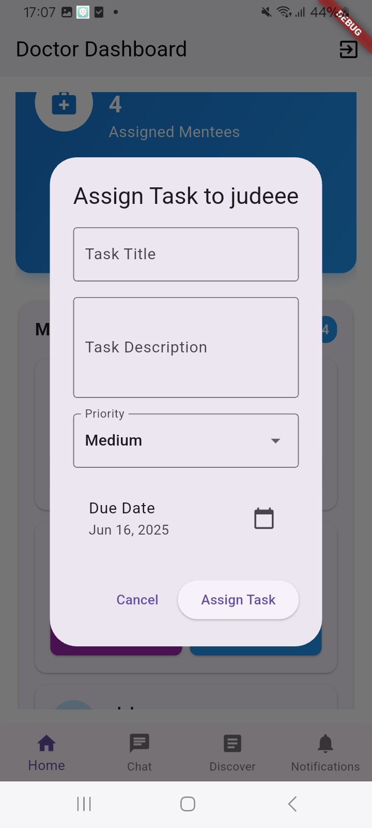
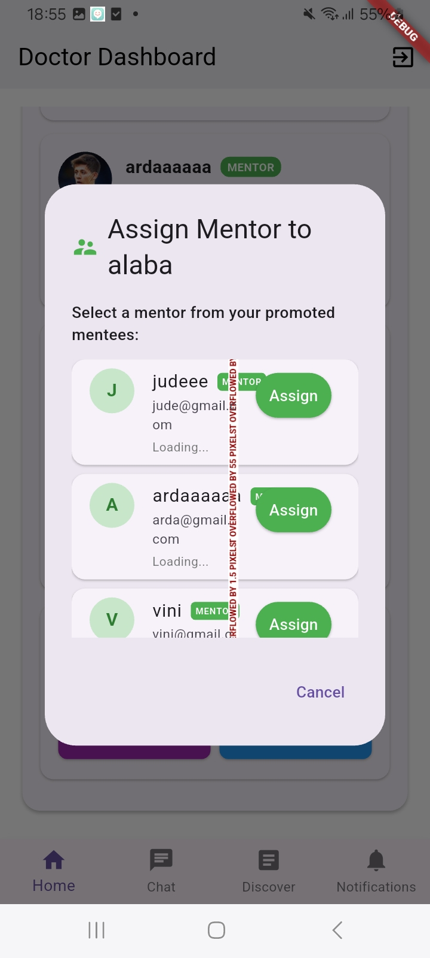
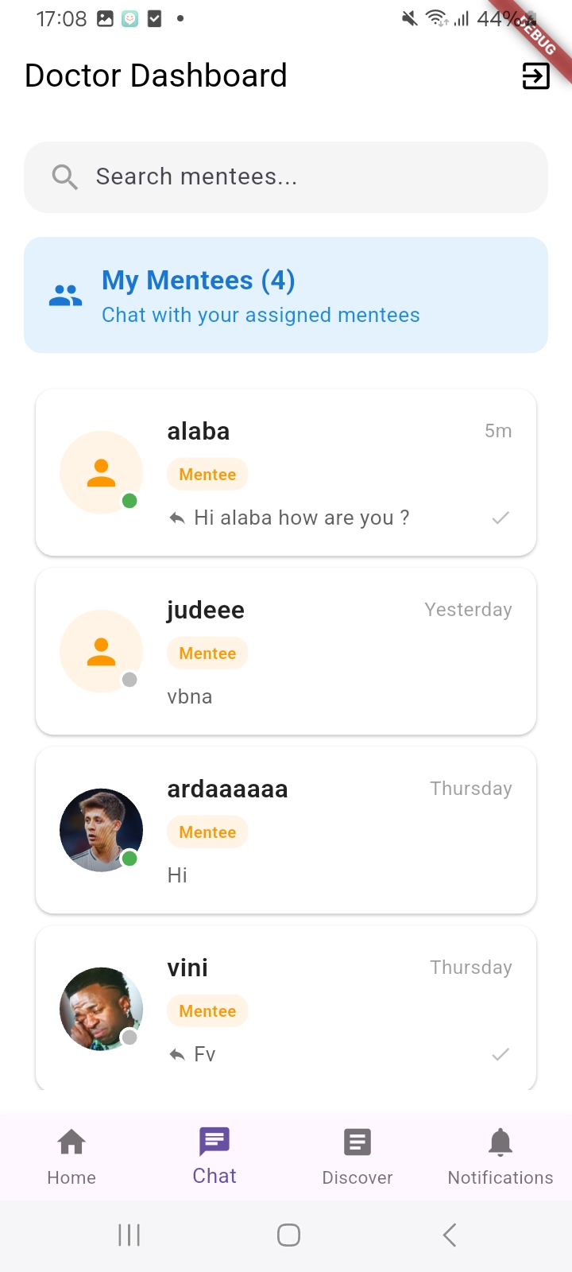
Doctor screens

Slide 12
Admin features
Add articles so users can read them and learn about gingival disease.
Promote mentees to mentors.
Assign doctors to mentees.
Approve or disapprove sign-up requests.
Manage his settings like other users

Slide 13
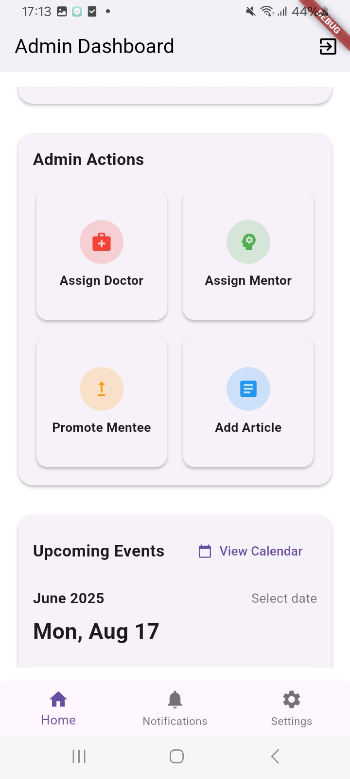
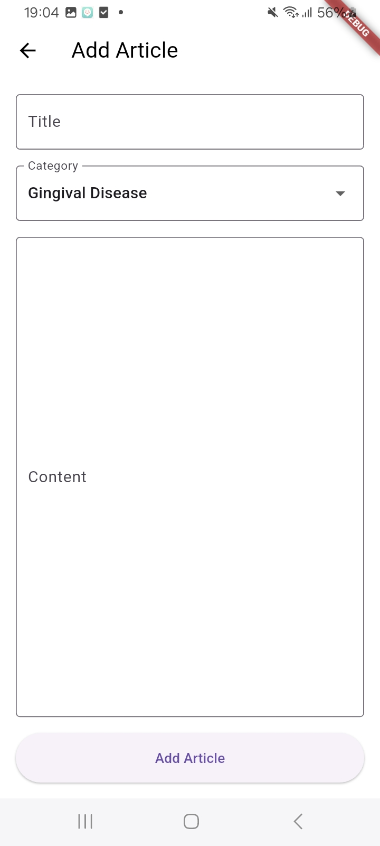
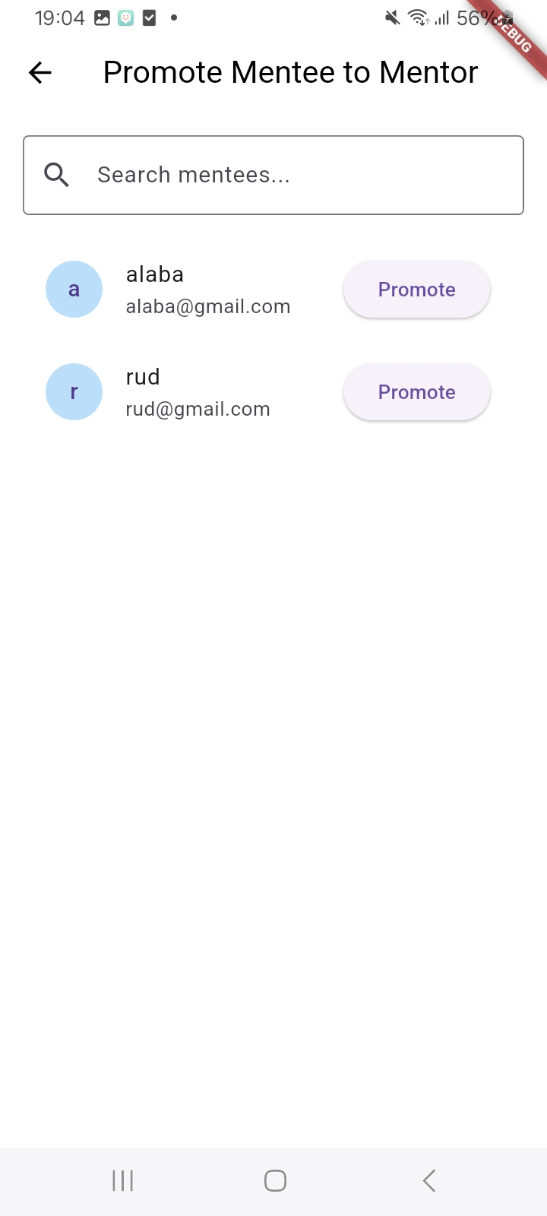
Admin screens

Slide 14
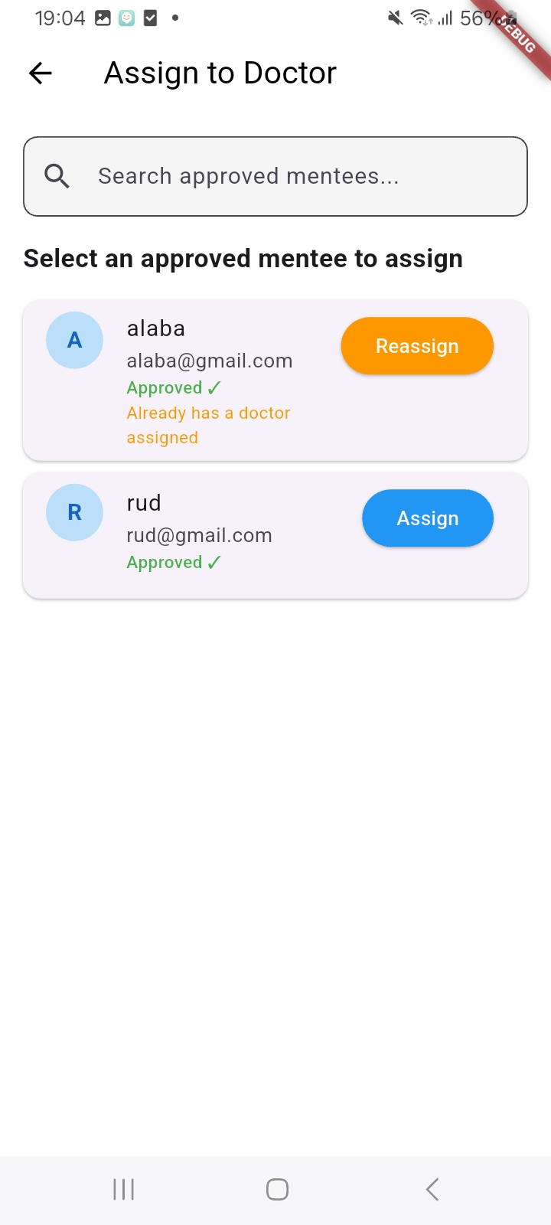
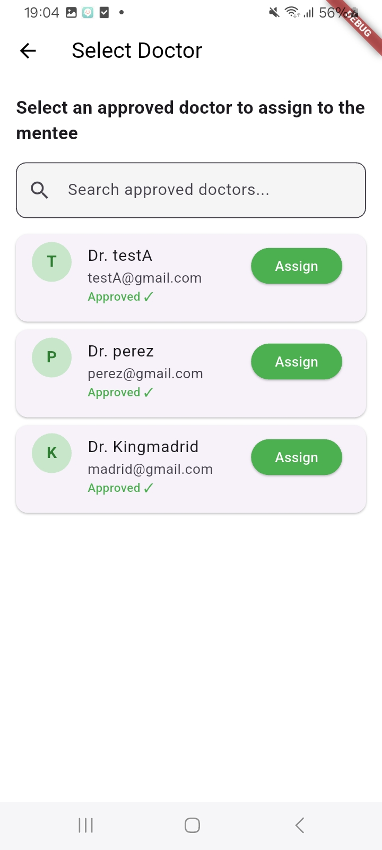

Slide 15
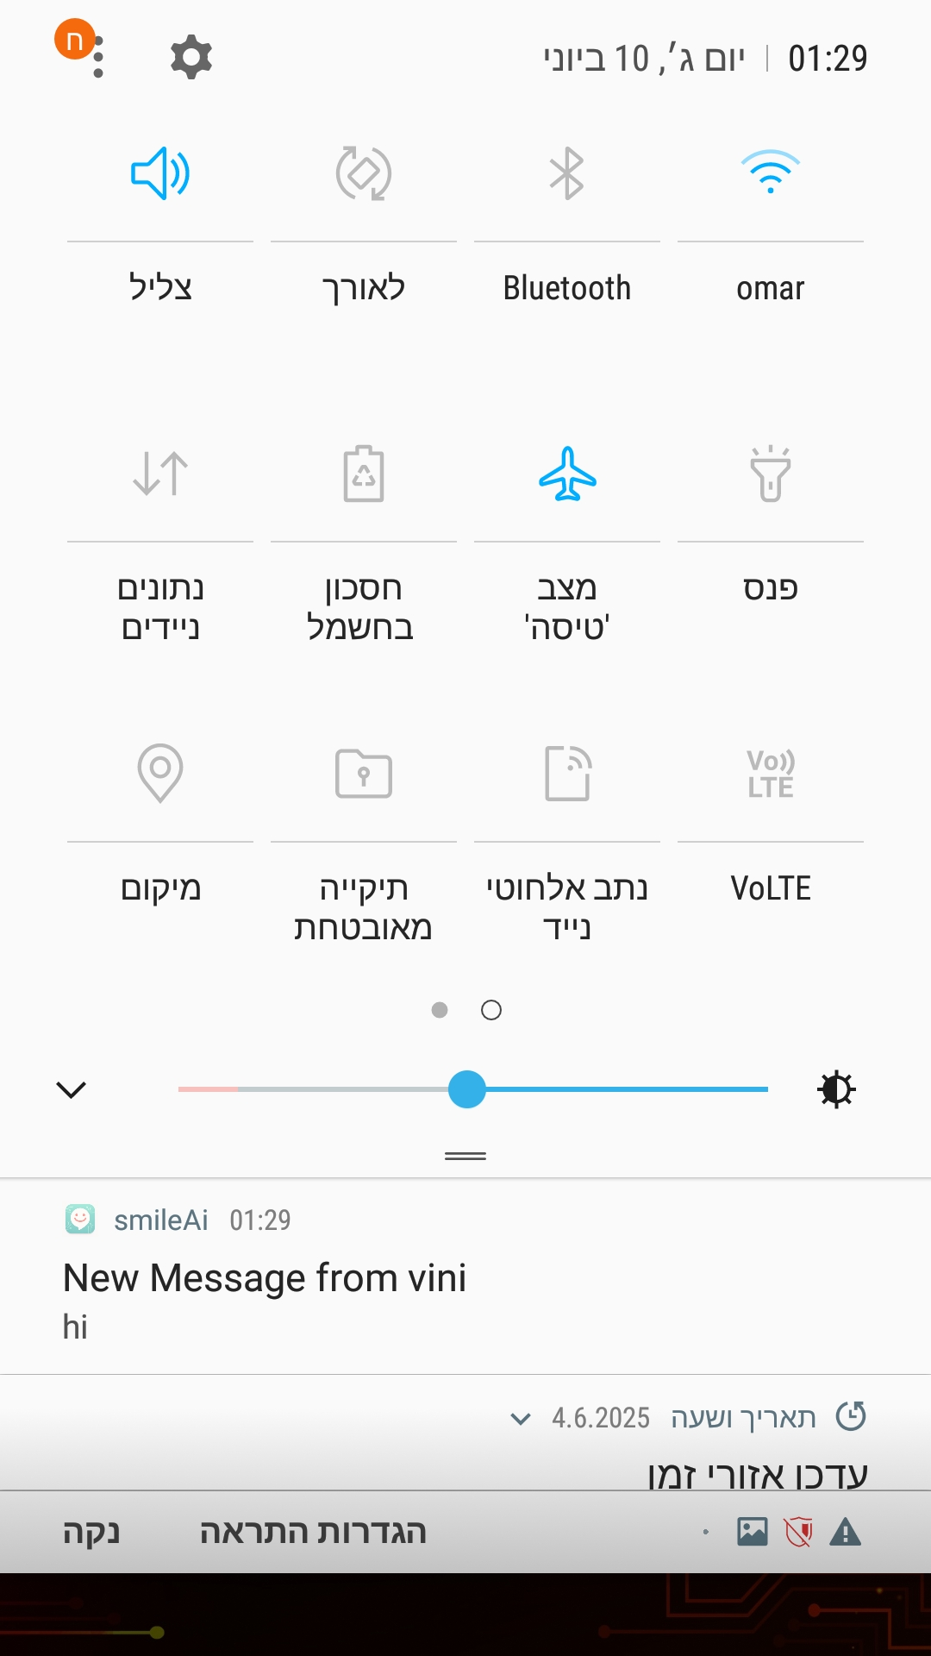
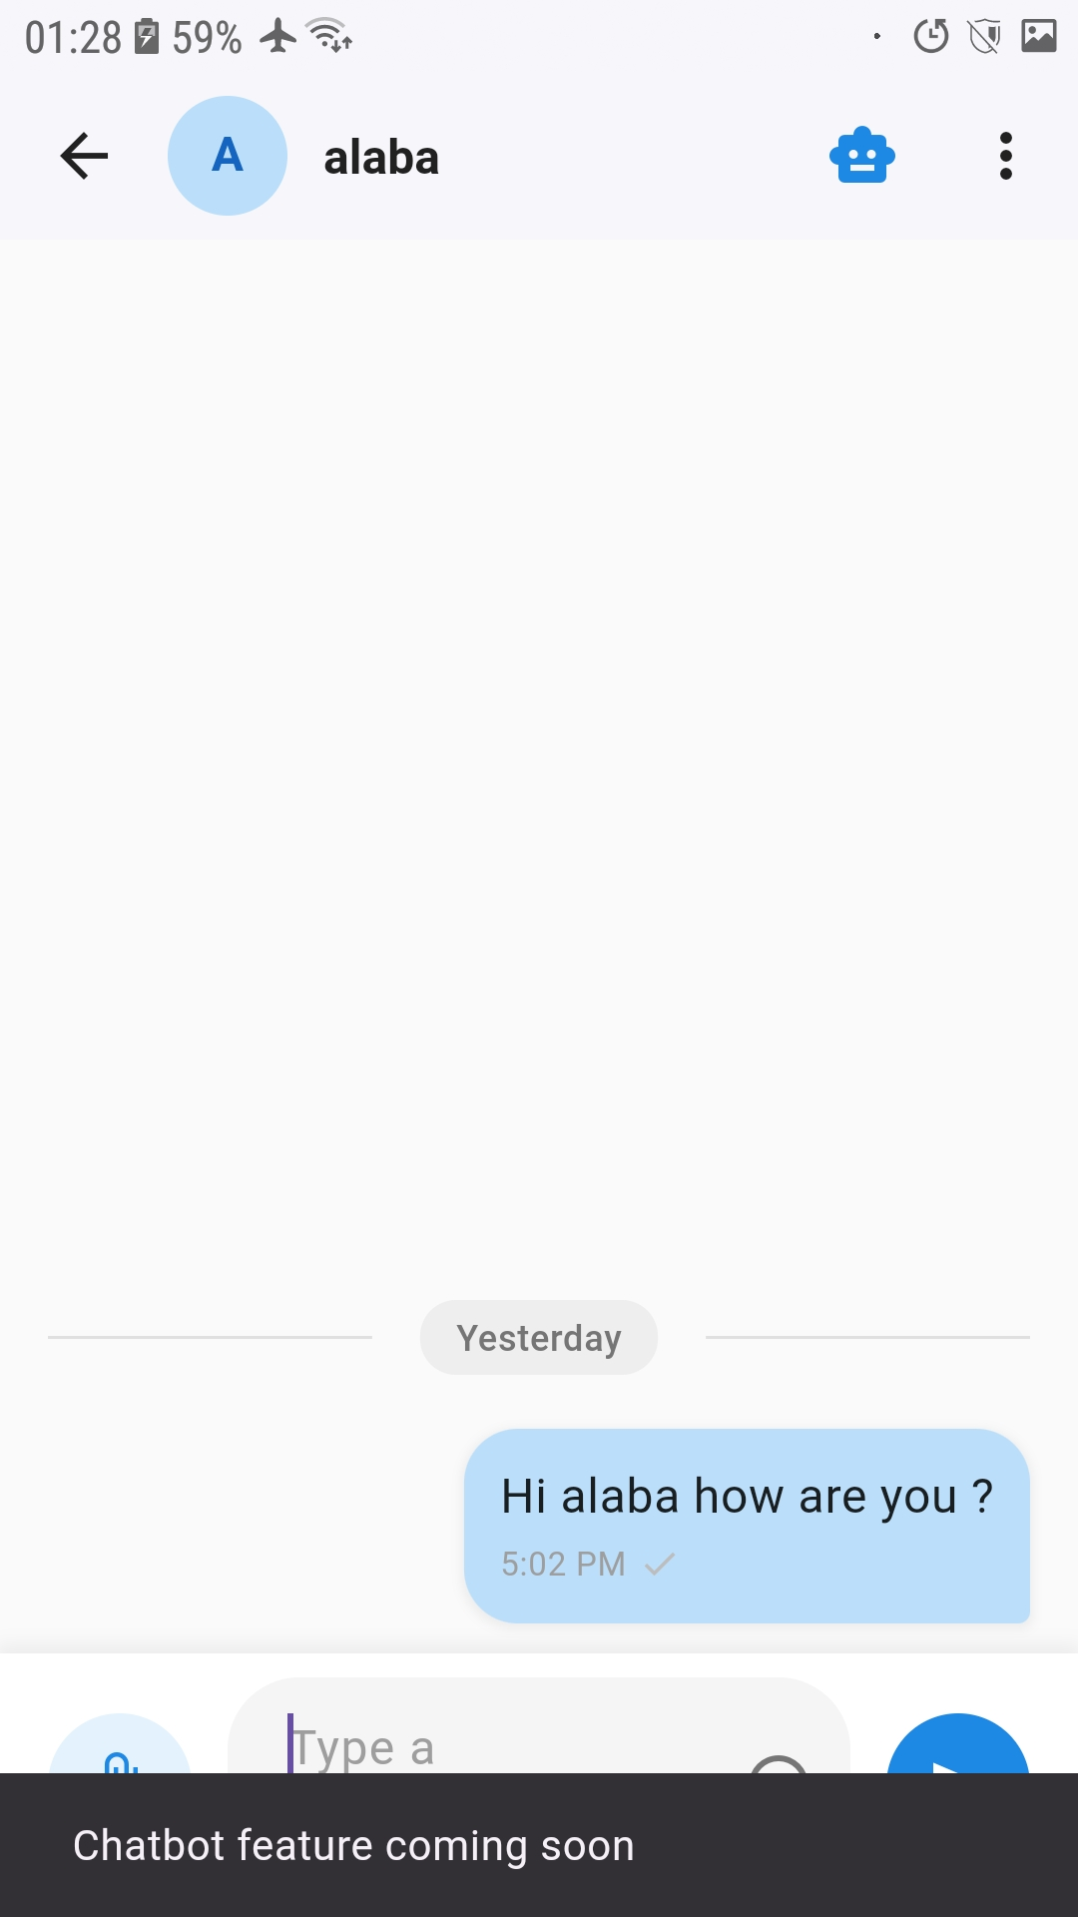
A CHALLENGE WE FACED

Slide 16
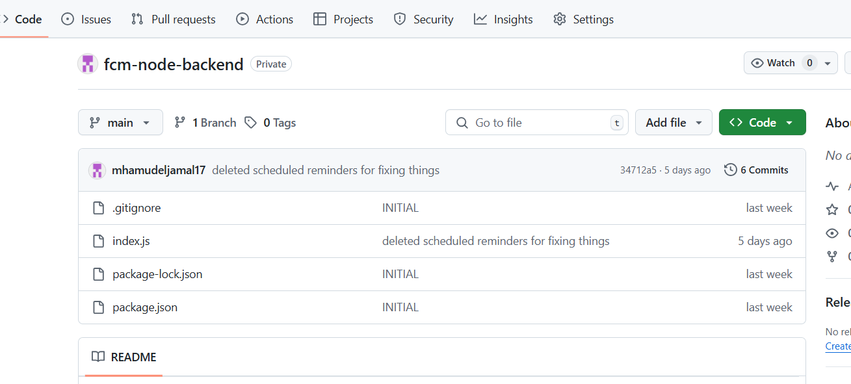
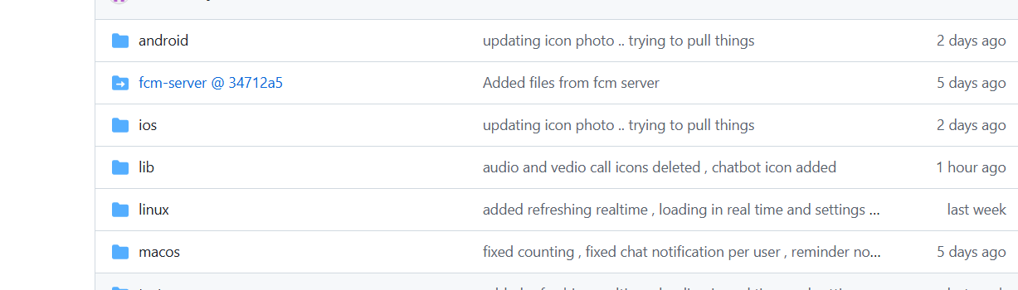

Slide 17
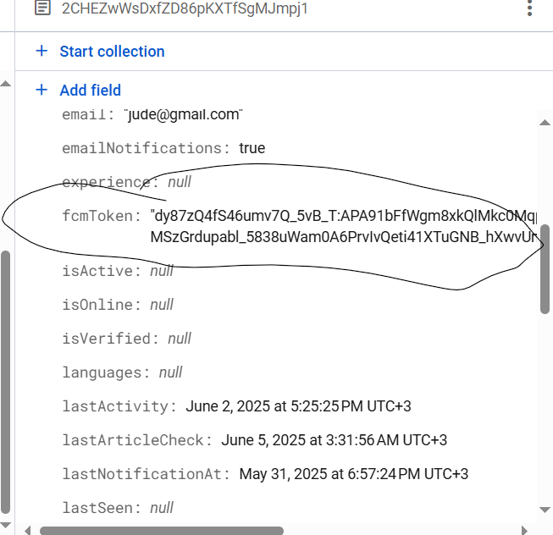
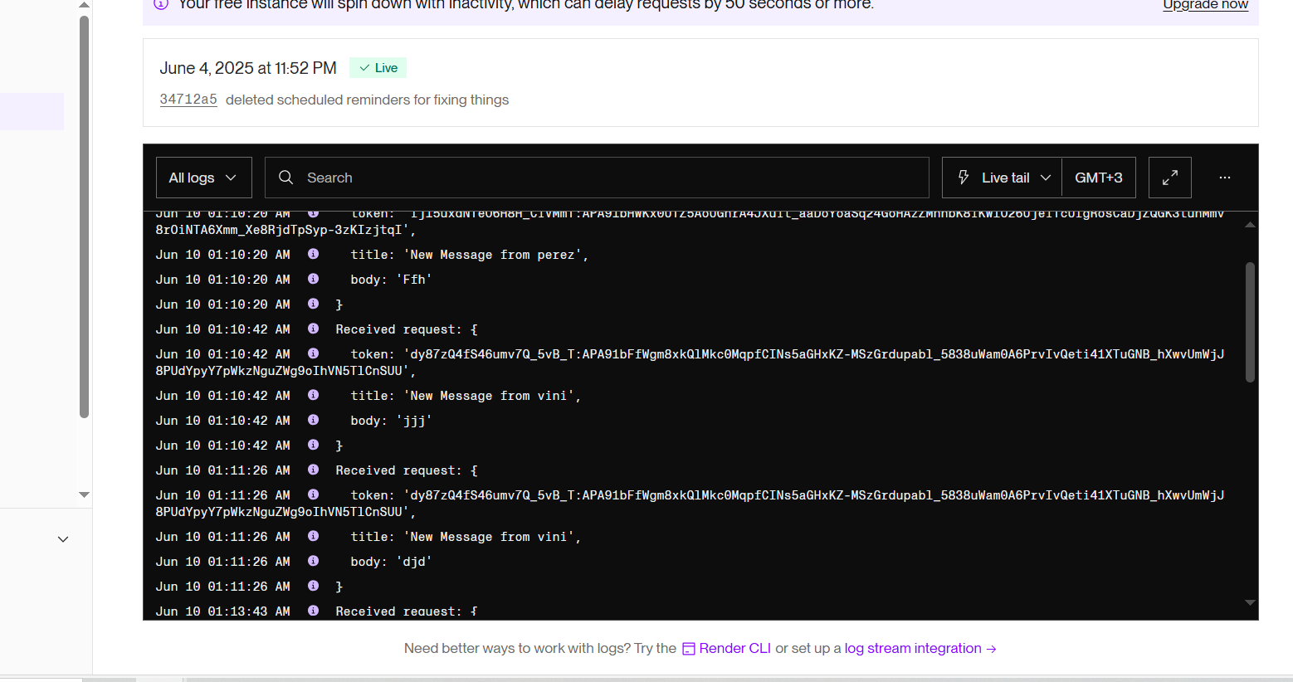

Slide 18
Plans for next sprint
Implementing the chatbot.
Implementing a calendar for all users to manage events.
Implementing the brushing buddy for mentees

